Slide 1




Battery Electric Storage Systems (BESS)

Slide 2
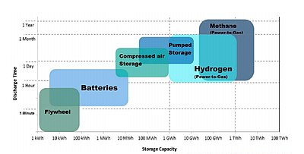
Different types of Storage
Source: School of Engineering RMIT, 2015

Slide 3
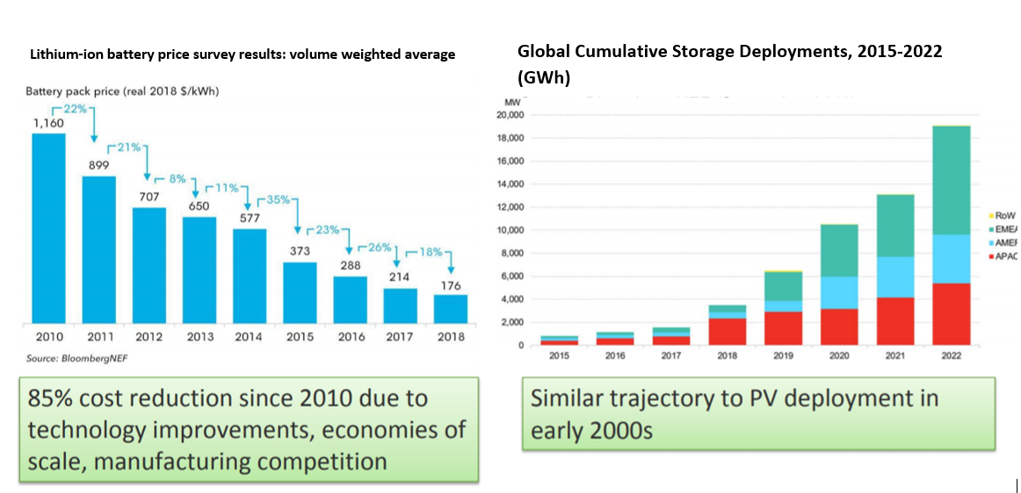
Evolution of cost and deployment of BESS
Source: NREL

Slide 4
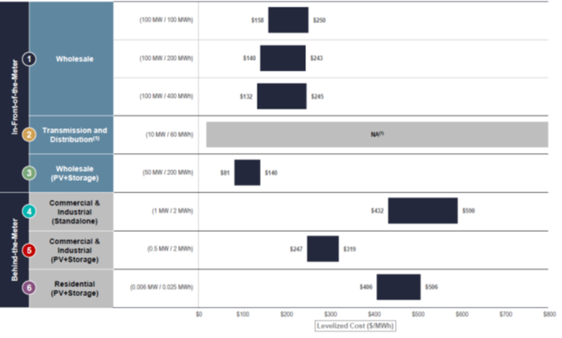
Levelized Costs of BESS (USD/MWh)
Source: Lazard 2020

Slide 5
Types of Integration
Hybridization
Standalone System
Hybrid Scheme
(at plant level)
Generator
Storage System
Converted Energy
(from Primary Source)
Converted Energy
(from Primary Source)

Slide 6
Benefits of a BESS to the System
Reduction in overall system operational costs
  Moving power from expensive generation to lower cost ones.
Avoiding RES curtailment.
  Storing power when there is not possible to accommodate all RES generation
Reduction in T&D investments
  Avoiding investments to supply peak power, obtaining it at the location it is needed
Provision of Ancillary Services
  Frequency Control (from seconds to several minutes)
  Voltage Control
Provision of capacity to the system

Slide 7
The challenge: Transforming “benefits” to “revenues”
For a developer, it is important that all these “benefits” could be monetized.
  Transformed into a revenue stream
  It is mandatory that all the “services” that BESS are adequately remunerated
Sources for the revenue stream
  Differences in marginal prices
    Arbitration (for a stand-alone system)
    Captured price (for a RES producer)
  Balancing market
  Capacity Auctions
  Ancillary Services provision
    Bands for frequency regulation (reserves market)
      Primary, secondary and tertiary reserves
      Fast frequency response

Slide 8
1 – Price Differences
Typical Generation Schedule

Slide 9
1 – Price Differences: Concept of “captured price”
In a market environment, the revenues for a RES producer (i.e., a solar PV producer) are linked with the marginal price, at the moment it generates.
  The “captured price”
Due to the large amount of PV solar developments, the marginal prices at noon reduces.
Therefore, even if the “average marginal price” is enough to justify a development, it could not be enough to justify it in cases it generates when the marginal price is low.
  The usual case
BESS helps to shift the generated energy from the zone of “low prices” to the zone of “higher prices”

Slide 10
2 – DESS in the Balancing Markets
Batteries may participate in the balancing market
  They are perfectly suited for this, since they can decide to generate or store energy, depending on the prices that appears in this market.
They can also sign long term contracts to provide this service to other parties (i.e., RES developers)

Slide 11
3. – BESS Capacity Payments / Capacity Markets
In several electricity markets, capacity is considered a “product” different than “energy”.
  Even markets which were created around the “only energy” concept, are now re-consider introducing payments to ensure enough capacity is available at moments in which the system is stressed.
Non-controllable RES do not receive capacity payments because they can’t ensure generation at such stressed periods.
  Or they receive only a marginal part
However, BESS or hybrid facilities can qualify to receive such compensations.

Slide 12
3. – BESS Capacity Payments / Capacity Markets
The capacity payment is a regulatory price, which is paid to all facilities which qualify
The capacity market is an auction for which the different providers guarantee certain amount of power (available at system stressed periods) in exchange for a payment ($/MW/year)
  The periods of awarding varies from 1 year to 15 years.
If a BESS or a hybrid facility is entitled to receive capacity payments and/or awarded in the capacity market it should:
  Participate in the day ahead market and in the balancing markets
  Ensure they have enough stored energy as to comply with the obligations assumed

Slide 13
4. – BESS Participation in the AA.SS. Markets
Fast Frequency Response
  It is recognized as a service in practically all markets
  However, it is not paid as a specific one in most of them
  Possibility to change in the near future
Secondary Reserve (FRR in Europe)
  Batteries can participate in the this market and receiving payments for acting through an AGC
  Timing for this market may deteriorate arbitrating opportunities for BESS
Voltage control is not considered a payable service in practically all markets.

Slide 14
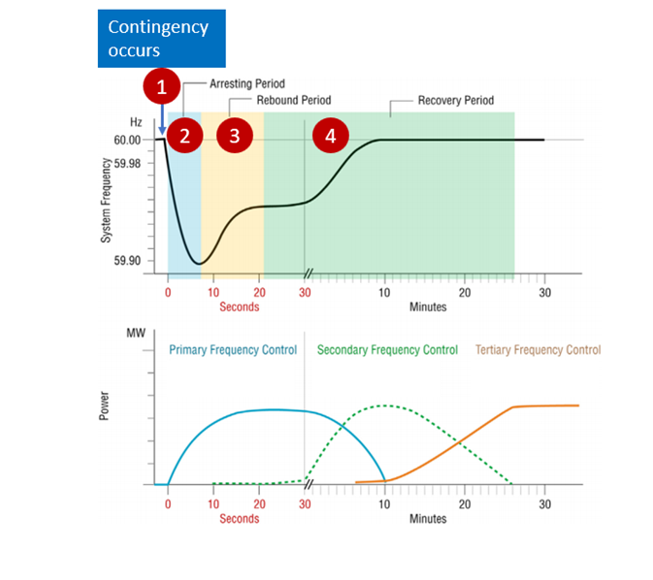
4. – Participation in the AA.SS. Markets

Slide 15
4. – BESS Participation in the AA.SS. Markets
Batteries are especially suitable for providing all types of reserve:
  Primary reserve (FCR in Europe) → Fast Frequency Response
  Secondary Reserve (FRR in Europe) → Receiving AGC signals
  Tertiary Reserve (RR in Europe)
They are also suitable to control voltage at selected busbars

Slide 16
Sources of Revenues
(Example form the Italian System)
LONG TERM CONTRACTS
According to the results of the matching between bids
€/MWh
LONG TERM PROCUREMENT OF AA.SS.
Not yet defined
It could be either based on €/MW or €/MWh
DAY AHEAD and INTRA-DAY MARKETS
DAM: According to the zonal system marginal price
IM: According to the results of the matching between bids
€/MWh
SPECIFIC PROCUREMENT PROCEDURES FOR AA.SS.
According to the system marginal price resulting from the procurement process
€/MW
IMBALANCE and SETTLEMENT Process
According to the Paid as Bid price accepted by the TSO
€/MWh
LONG TERM PROCUREMENT OF STORAGE CAPACITY
According to the system marginal price cleared for each standard product (RR, mFRR, aFRR)
€/MW
EU BALANCING PLATFORMS
According to the system marginal price cleared for each standard product (RR, mFRR, aFRR)
€/MWh
CAPACITY MARKET
According to the system marginal price of the main auction for existing resources (1 year) or new resources (15 years)
€/MW/Year

