Slide 1
Electricity Markets Training Program
(EMTP Session 04)

Slide 2
High Level Outline

Slide 3
High Level Outline
Transmission by Aitzaz Hussain
Demand Management by Aitzaz Hussain
Quiz
Q & A session

Slide 4
Meet The Team for Session 04
Panelist
Presenter
Omer H. Malik
Aitzaz Hussain
Board Member – APEx
Course Director - EMTP
DM Market Design & Simulation
CPPA-G

Slide 5
Transmission

Slide 6
Why is the study of transmission vital for studying markets?

Slide 7
Motivation
Transmission system acts as Market Enabler
Transmission System Realities Impacts Market Model & Products
Transmission Constraints Alter Behavior of Market Participants
Different Markets and their role in the industry

Slide 8
Topic Map: What Will We Study Today?
Thermal Limits
Power Triangle
Phase Difference
Transmission Capacity
Limits
Per Unit System
Active Power
Voltage Stability Limits
Line Model
Reactive Power
Angular Stability Limits
Surge Impedance Loading
Apparent Power

Slide 9
Introduction to Transmission

Slide 10
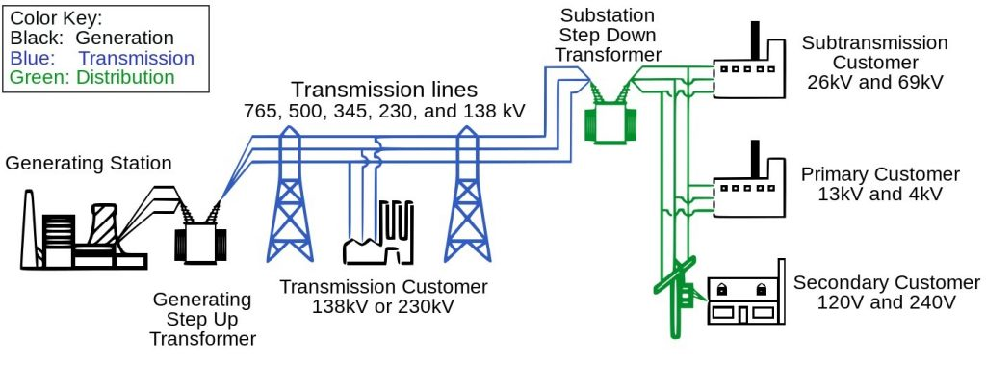
Supply Chain
Generation
Transmission
Distribution

Slide 11
Types of Transmission System

Slide 12
Types of Transmission System
AC Transmission System
DC Transmission System
Different Markets and their role in the industry

Slide 13
Features of AC Transmission System
Mature Technology
Lower Initial Cost
Simpler Infrastructure Requirement
Different Markets and their role in the industry

Slide 14
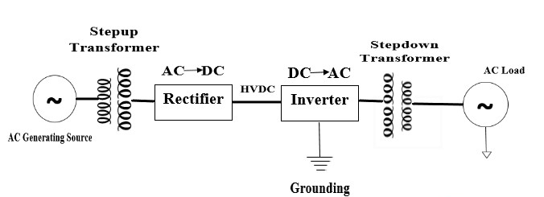
Features of DC Transmission System
Better Interoperability between two systems at different frequencies
Efficient Long-Distance Transmission
Better Controllability
Higher Initial Costs
Different Markets and their role in the industry

Slide 15
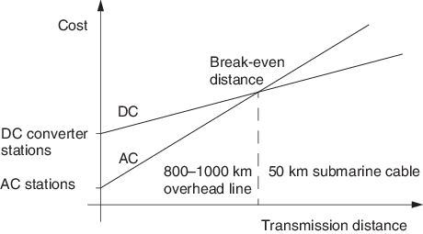
Which Technology Should You Choose?
Different Markets and their role in the industry

Slide 16
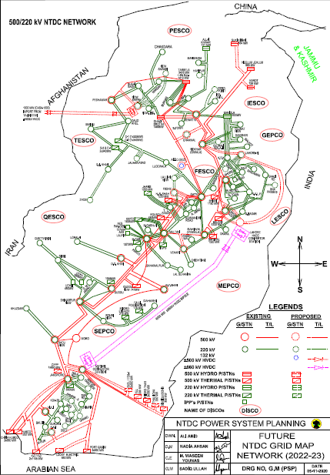
Transmission Network of Pakistan
Different Markets and their role in the industry

Slide 17
Power Triangle

Slide 18
Topic Map
Thermal Limits
Power Triangle
Phase Difference
Transmission Capacity
Limits
Per Unit System
Active Power
Voltage Stability Limits
Line Model
Reactive Power
Angular Stability Limits
Surge Impedance Loading
Apparent Power

Slide 19
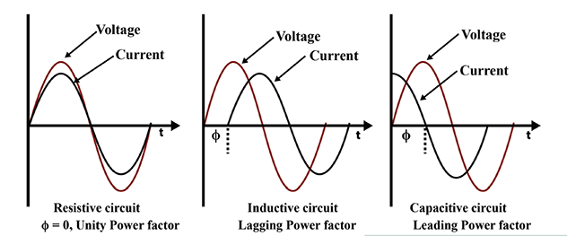
Power Triangle: Phase Difference
Different Markets and their role in the industry
Resistive Load
Inductive Load
Capacitive Load

Slide 20
Power Triangle: Active Power
Active Power (P) is the actual power that is consumed, converted, or dissipated in an electrical circuit, producing useful work
P = V I cos(φ)
Where:
P = Active Power (in watts)
V = Voltage (in volts)
I = Current (in amperes)
φ = Angle between voltage and current (power factor angle)
Different Markets and their role in the industry

Slide 21
Power Triangle: Reactive Power
Reactive power is a component of electrical power that does not perform useful work but rather oscillates back and forth between the source and the load in an alternating current (AC) electrical system
Q = V I sin(φ)
Where:
Q = Reactive Power (in VAR)
V = Voltage (in volts)
I = Current (in amperes)
φ = Angle between voltage and current
Different Markets and their role in the industry

Slide 22
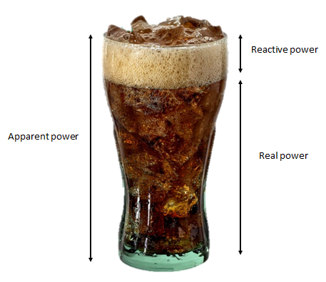
Power Triangle: Apparent Power
Apparent power is the product of the total current and voltage in a circuit
S = V I
Where:
S = Apparent Power (in VA)
V = Voltage (in Volts)
I = Current (in Amperes)
Different Markets and their role in the industry

Slide 23
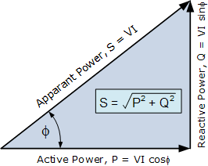
Power Triangle
Apparent Power = S = IV
Active Power = P = S Cos (φ)
Reactive Power = Q = S Sin (φ)
Different Markets and their role in the industry

Slide 24
Example: Power Triangle
Active Power = P = 9 MW
Reactive Power = Q = 0 MVAR
Different Markets and their role in the industry

Slide 25
Example: Power Triangle
We have a predominantly inductive system with following characteristics:
Active Power = P = 9 MW
Reactive Power = Q = 9 MVAR
What is the Power Factor? Comment on the type of load.
What happens when we add a capacitor of 6 MVAR?
Different Markets and their role in the industry

Slide 26
Representing of Transmission System

Slide 27
Single Line Diagram
Different Markets and their role in the industry

Slide 28
Per Unit System

Slide 29
Topic Map
Thermal Limits
Power Triangle
Phase Difference
Transmission Capacity
Limits
Per Unit System
Active Power
Voltage Stability Limits
Line Model
Reactive Power
Angular Stability Limits
Surge Impedance Loading
Apparent Power

Slide 30
Per Unit System
Convenient way of representing system quantities
Quantity Per Unit = $\frac{Actual Value in Any Unit}{Base of Reference Value in the Same Unit}$
Benefits:
Suspect Values are easily identified
Makes calculation simpler
$\text{S}PU$=$\frac{\text{S}}{\text{S}\text{base} }$ , $\text{V}PU$=$\frac{\text{V}}{\text{V}\text{base} }$ , $\text{I}PU$=$\frac{\text{I}}{\text{I}\text{base} }$ , $\text{Z}PU$=$\frac{\text{Z}}{\text{Z}\text{base} }$
Different Markets and their role in the industry

Slide 31
Example: Per Unit System
Let’s convert the voltages into Per Unit System
Different Markets and their role in the industry

Slide 32
Transmission Line Model

Slide 33
Topic Map
Thermal Limits
Power Triangle
Phase Difference
Transmission Capacity
Limits
Per Unit System
Active Power
Voltage Stability Limits
Line Model
Reactive Power
Angular Stability Limits
Surge Impedance Loading
Apparent Power

Slide 34
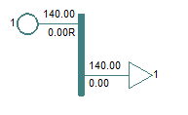
Hypothetical Single Bus System
If the Generator is connected directly to the load, how would the system behave?
System Parameters:
A Resistive Load consuming 140 MW

Slide 35
Example: Adding a Transmission Line
Let’s a 30km 132kV Conductor in the example from the previous slide

Slide 36
Example: Adding a Transmission Line
What happens when the load drops by a factor of 10?

Slide 37
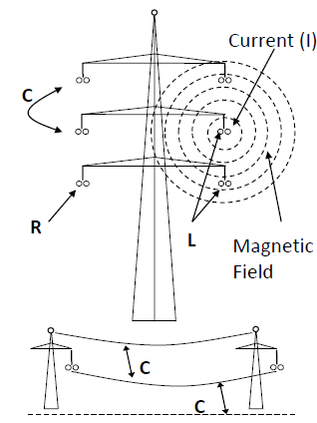
How Can T/Lines Be Modelled Mathematically?
Can be modeled through Resistance (R), Reactance (X) and Susceptance (B)
Different Markets and their role in the industry

Slide 38
Surge Impedance Loading

Slide 39
Topic Map
Thermal Limits
Power Triangle
Phase Difference
Transmission Capacity
Limits
Per Unit System
Active Power
Voltage Stability Limits
Line Model
Reactive Power
Angular Stability Limits
Surge Impedance Loading
Apparent Power

Slide 40
Surge Impedance Loading
Surge Impedance Loading (SIL) represents the maximum power that can be transferred through a transmission line keeping a flat voltage profile between sending end and receiving end
$SIL$=$\frac{{\text{V}}^{2}}{\text{Z}\text{0} }$
Where:
V is the voltage and $\text{Z}\text{0}$ is the surge impedance
$\text{Z}\text{0}$ can be approximated as:
$\text{Z}\text{0}$=$\sqrt{\frac{\text{X}}{\text{B} }}$
Different Markets and their role in the industry

Slide 41
Example: Surge Impedance Loading
A 132kV Line has X= 0.06588 PU and B= 0.01572 PU at (100MVA Base Power ($\text{S}\text{base}$) & 132kV Base Voltage ($\text{V}\text{base}$)). Find Surge Impedance Loading in MW ($\text{Z}\text{base}$=$\frac{{\text{V}\text{base}}^{2}}{\text{S}\text{base}}$ )
Useful Formulas are given below
$SIL$=$\frac{{\text{V}}^{2}}{\begin{aligned}\text{Z}\text{0} \\ \end{aligned}}$
$\text{Z}\text{0}$=$\sqrt{\frac{\text{X}}{\text{B} }}$
$\text{Z}\text{pu}$=$\frac{\text{Z}\text{Actual}}{\text{Z}\text{Base}}$
Different Markets and their role in the industry

Slide 42
SIL: Heavily Loaded System

Slide 43
SIL: Lightly Loaded System

Slide 44
Example: Surge Impedance Loading
What happens when the line is loaded at SIL?

Slide 45
Transmission Capacity

Slide 46
Topic Map
Thermal Limits
Power Triangle
Phase Difference
Transmission Capacity
Limits
Per Unit System
Active Power
Voltage Stability Limits
Line Model
Reactive Power
Angular Stability Limits
Surge Impedance Loading
Apparent Power

Slide 47
Transmission Capacity
Transmission capacity refers to the maximum amount of power that can flow through the electrical transmission network between specific points
Different Markets and their role in the industry

Slide 48
Transmission / Power Transfer Capacity
Thermal Limit
Voltage Stability Limit
Angle Stability Limit
Different Markets and their role in the industry

Slide 49
Thermal Limits

Slide 50
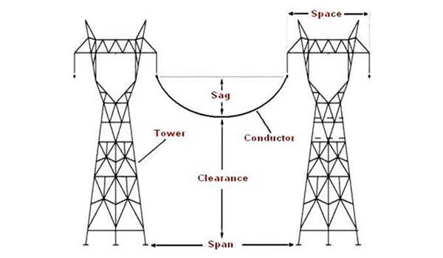
Thermal Limits
Increasing power flow in a line increases current
Increasing current produces heat
Causes the line to expand and sag
Line may lose strength due to this expansion if heated over its material recommended limits
Each transmission line is assigned a thermal rating denoting the maximum current it can safely transfer
The thermal rating is the power that can continuously flow on the line without causing overheating or damage
Different Markets and their role in the industry

Slide 51
Thermal Limits
Voltage (kV) | Conductor | Thermal Rating
 |  | Current (A) | MVA
500 | Greeley 4-c | 806 | 2793
500 | Drake 4-c | 800 | 2772
220 | Rail 2-c | 884 | 674
220 | Rail 1-c | 884 | 337
132 | Rail | 884 | 202
132 | Lynx | 488 | 112
66 | Dog | 338 | 39
Different Markets and their role in the industry

Slide 52
Voltage Stability Limits

Slide 53
Voltage Stability Limit
Refers to the maximum limit of a Power System’s voltage level beyond which the system may experience voltage collapse or instability
To maintain voltage stability, power systems typically have specified tolerance levels for voltage variation (usually ±5% of nominal voltage)
Major cause of voltage drop is the lack of reactive power
Different Markets and their role in the industry

Slide 54
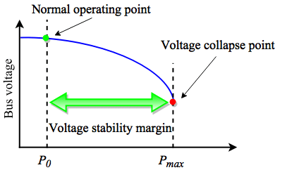
Voltage Limit: P-V Curve
The P-V (Power-Voltage) curve is a graphical representation that shows the relationship between the power transfer on a transmission line and the voltage at the receiving substation
Different Markets and their role in the industry

Slide 55
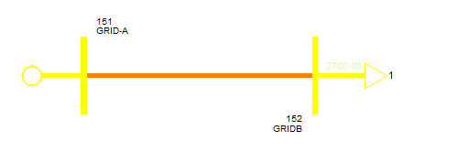
Example: Generator Connected With 500kV Line
A Generator connects 500kV Transmission Line on Drake Conductor to a load
Connection Arrangement 1: Connection is through 10 KM Short Line
Connection Arrangement 2: Connection is through 100 KM Medium Line
Different Markets and their role in the industry

Slide 56
How Would This Simulation Work?
The simulator would continue increasing the load in step
Increased load would increase the generation
Then it would record voltage at the Receiving End for each load step increase
Different Markets and their role in the industry

Slide 57
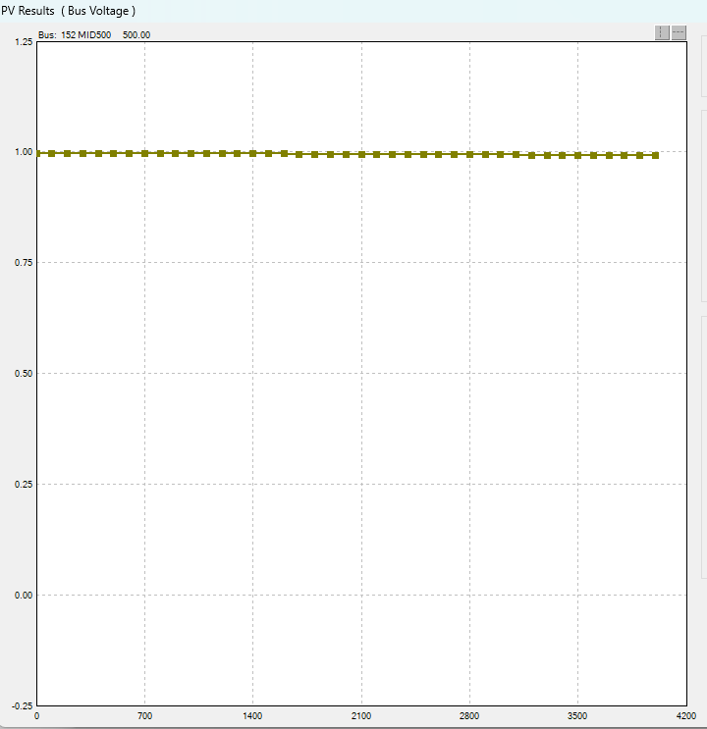
Case 1: 10km 500kV Drake Line
Different Markets and their role in the industry

Slide 58
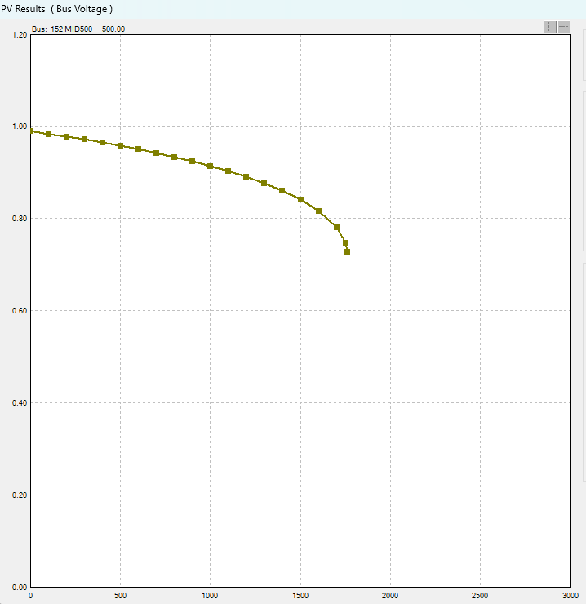
Case 2: 100km 500kV Drake Line
Different Markets and their role in the industry

Slide 59
How to Improve Voltage Stability
Different Markets and their role in the industry

Slide 60
Angular Stability Limits

Slide 61
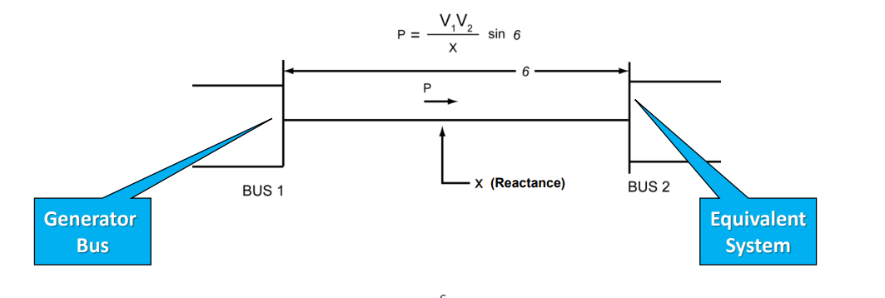
Angle Stability Limit
MW flow between buses is determined by phase angle difference between voltages at the buses.
Phase angle difference between voltages is called Power Angle which is represented by the symbol δ.
Different Markets and their role in the industry

Slide 62
Synchronism in Power System
Different Markets and their role in the industry

Slide 63
Example: A Long Line Connecting Two Generators
A long line connects generator in the following configuration
500kV Long Line connects a resistive load of 5000 MW
NUC-B is generating at 950 MW, while NUC-A is generating 4050MW
Bus labelled NUCPANT has a load of 5000 MW
Let’s analyze the system for any potential angular stability limits
Different Markets and their role in the industry

Slide 64
Is This Case Stable With Regards to Voltage?
Different Markets and their role in the industry

Slide 65
How Would Dynamic Simulation Work?
We would run the system dynamically for 1s
A fault occurs at time stamp of 1s
The fault is cleared in 5 cycles of 0.1 seconds and cleared after it
The system is allowed to run for 10s and the plots of rotor angles are observed
Different Markets and their role in the industry

Slide 66
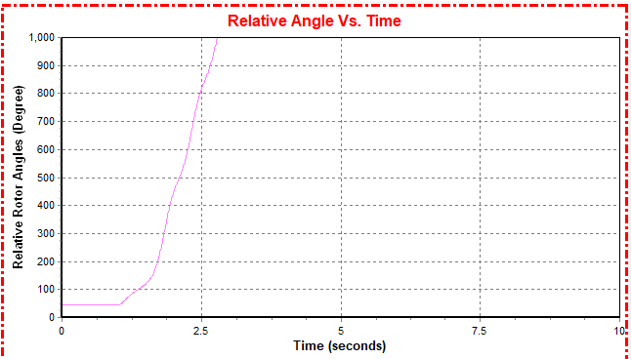
Results of Dynamic Simulation
Different Markets and their role in the industry

Slide 67
Reducing Flow from 950MW to 500MW on Transmission Line
Different Markets and their role in the industry

Slide 68
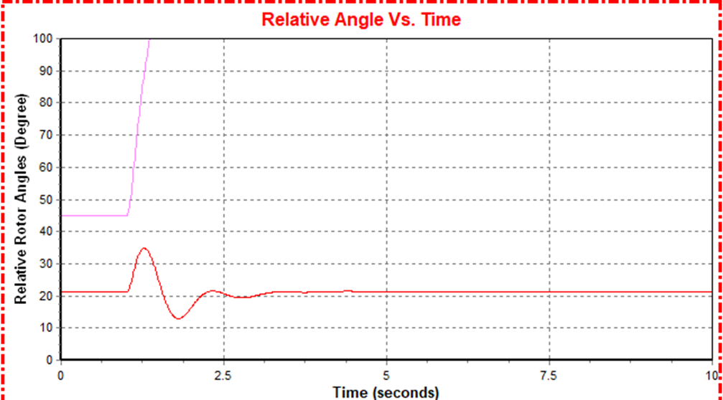
What Happens to the Angular Stability?
Different Markets and their role in the industry

Slide 69
Binding Limits - Summary
Short Transmission Lines
(Up to 50 Miles)
Binding Limit
Medium Transmission Lines
(50-150 Miles)
Binding Limit
Binding Limit
Long Transmission Lines
(>150 Miles)

Slide 70
DEMAND MANAGEMENT

Slide 71
Introduction
Demand management in the context of electricity markets is a critical aspect of ensuring the reliable and efficient supply of electrical energy
It refers to:
The planning and controlling of electricity consumption to balance the grid
Reducing peak demand
Optimizing resource utilization
Demand management in electricity markets, from the demand side perspective, is vital for grid reliability, cost efficiency, environmental sustainability, and overall energy system optimization
It empowers consumers to make informed choices while helping utilities and grid operators manage and balance the electricity grid effectively

Slide 72
Methods For Today’s Discussion
Demand Control
Demand Response
Energy Efficiency

Slide 73
Economics of Demand Control

Slide 74
Demand Response

Slide 75
Demand Response
DR represents a set of solutions deployed with the goal to change the peak load of electricity consumption.
The overall energy consumption over long term remains the same, however, the peak is capacity is optimized when system is stressed and vulnerable
Demand response is based on two main mechanisms:
Price-based Programs: Use price signals and tariffs to incentivize consumers to shift consumption
Incentive-based Programs: Programs which make direct payments to consumers who shift demand as part of a demand-side response program.

Slide 76
Demand Response Methods
Demand Control Methods
Incentive Based Methods
Price Based Methods
Time of Use
Real Time Pricing
Critical Peak Pricing
Interruptible /Curtailable Service
Direct Load Control

Slide 77
Price Based Methods: Time of Use Pricing
Under TOU pricing, the electricity rate is divided into different time periods, typically with higher rates during peak periods and lower rates during off-peak and shoulder periods
TOU rate has 2 time blocks: Peak and Off-peak and these rates are given to the customer in a particular season.
This program offers different rates of electricity price per unit in different blocks of time reflecting the average cost of electricity in different time period.

Slide 78
Price Based Methods: Real-time Pricing
RTP provides consumers with dynamic electricity prices that change in real-time based on fluctuations in supply and demand
These program rates vary continuously in day time and directly reflect the wholesale price of electricity market
This program offers hourly price rates linked to hourly changes in real time cost of power
The real-time pricing (RTP) scheme is an ideal method to adjust the power balance between supply and demand in smart grid systems
This scheme has a profound impact on users’ behavior, system operation, and overall grid management in the electricity industry

Slide 79
Price Based Methods: Critical Peak Pricing
In CPP programs, the electricity rate increases significantly during critical peak periods when demand is exceptionally high encouraging curtailment
The critical peak time period defines high specified per unit rate for usage during load time
These programs usually occur 6-10 hours in a season with relatively short time period notice
Similar to TOU with a much higher peak pricing when system reliability is compromised or when supply costs are very high

Slide 80
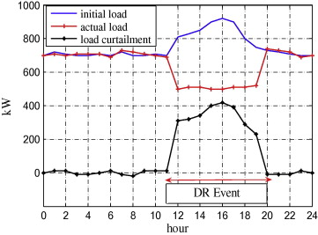
Incentive Based Methods: Interruptible/Curtailable Loads
Interruptible or curtailable loads are specific types of demand response resources in incentive-based demand response programs that can be temporary interrupted or reduced
The signal for curtailment or interruption is sent from utilities or grid operators during periods of peak demand or grid stress
Customers on Interruptible/Curtailable service tariffs receive a discount or bill credit in exchange for agreeing to reduce load during system contingencies
If customers do not curtail, they can be penalized
Interruptible load (IL) users can sign contracts with power supply companies, allowing them to break the power supply under different specific conditions

Slide 81
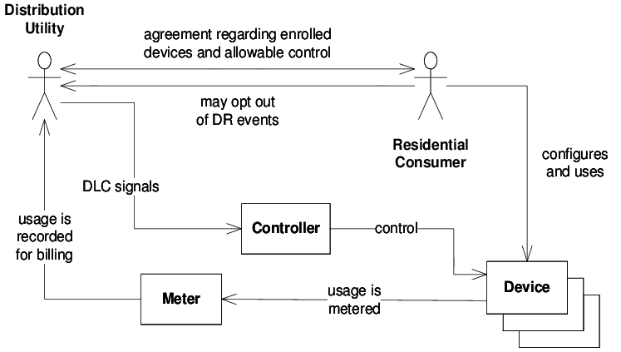
Incentive Based Methods: Direct Load Control
Direct Load Control (DLC) is a strategy that allows utilities or grid operators to directly control or adjust the operation of specific electricity-consuming devices or appliances at the consumer's premises
Done remotely through communication networks and advanced metering infrastructure, enabling the utility to manage electricity demand during peak periods or grid emergencies
In return Consumer get lower electric bills and other financial incentives
DLC is also operated to avoid peak time electricity purchases
These programs are voluntary so that consumers are not penalized if they don’t accept the offer

Slide 82
Energy Efficiency

Slide 83
Energy Efficiency
Energy efficiency plays a critical role in demand management by reducing the overall electricity consumption without compromising the desired energy services during peak and off-peak conditions
Achieving energy efficiency requires a comprehensive understanding of the devices that influence overall system efficiency and employing various methods to optimize their performance
Energy efficiency measures help lower the baseline electricity consumption of consumers
Energy efficiency measures seek to minimize energy waste, maximize the output of energy services, and reduce the need for additional power generation

Slide 84
Energy Efficiency: Key Methods
Energy-Efficient Design: This technique involves using advanced technologies, materials, and engineering techniques to reduce energy losses and maximize the device's energy output for a given level of energy input
Energy Management Systems: Implementing energy management systems, such as smart grids and smart meters, allows for real-time monitoring and control of energy consumption. This helps identify energy inefficiencies and allows for automated load adjustments during peak demand periods
High-Efficiency Appliances and Lighting: Replacing old or inefficient appliances and lighting with high-efficiency models significantly reduces energy consumption. Energy-efficient appliances and LED lighting, for example, use less electricity to provide the same level of service

Slide 85
Energy Efficiency: Key Methods
Energy Audits and Efficiency Measures: Conducting energy audits to assess energy consumption patterns and identifying opportunities for efficiency improvements. Implementing efficiency measures based on audit findings can lead to targeted energy savings
Industrial Process Optimization: In industrial settings, optimizing processes and equipment can lead to significant energy savings. This may involve improving production efficiency, reducing energy-intensive processes, and adopting energy-efficient technologies
Behavioral Changes and Education: Raising awareness and educating consumers and employees about energy-efficient practices can lead to behavioral changes that contribute to improved energy efficiency

Slide 86
Benefits & Challenges in Implementing Demand Control Programs

Slide 87
Benefits of Demand Control Programs
Improve the efficiency of energy systems and system load factor
Reduce financial needs to build new energy facilities (generation) – through deferral of capital expenditure resulting from peak demand reduction
Minimize adverse environmental impacts – reduction of GHG emissions
Lower the cost of delivered energy to consumers – lower generation costs and lower customer bills through the use of energy efficient equipment and appliances

Slide 88
Benefits of Demand Control Programs
Reduce power shortages and power cuts – improved system reliability though decrease in demand
Improve the reliability and quality of power supply – through demand reduction in distribution systems
Contribute to local economic development – increased employment through reallocation of capital to other development projects

Slide 89
Challenges in Implementing Demand Control Programs
Upfront Costs: Implementing these programs may require significant initial investments in infrastructure, technology, and marketing
Consumer Resistance: Some consumers may be reluctant to participate in Demand Control programs due to concerns about changes in their energy usage habits or privacy concerns
Complexity and Coordination: Coordinating various Demand Control initiatives, demand response events, and energy efficiency programs can be challenging for utilities and program administrators

Slide 90
Challenges in Implementing Demand Control Programs
Limited Participation: Not all consumers may be willing or able to participate in these programs, limiting the overall impact on reducing peak demand
Risk of Overestimation or Underestimation: There is a risk of overestimating or underestimating the actual impact of these programs, which could lead to suboptimal outcomes
Dependency on Consumer Engagement: The success of Demand Control heavily relies on active consumer engagement, which can be difficult to achieve uniformly

Slide 91
Questions ?

